Slide 1

FPT University
Android programMing
Lesson 17
Version 1.0

Slide 2
Agenda
Accessing Cloud Storage using the Android Storage Access Framework

Slide 3
Accessing Cloud Storage using the Android Storage Access Framework
Wide adoption of remote storage services in recent years. Driving this growth are two key factors
Mobile devices now provide continuous, high speed internet connectivity
The incompatible between mobile storage and traditional computer system

Slide 4
Accessing Cloud Storage using the Android Storage Access Framework
1. Latest Software 2. Minimize IT infrastructure 3. Flexibility of costs 4. Remarkable availability 5. Enhanced mobility 6. Enhanced collaboration | 7. Cost effectiveness 8. Instantaneous reduction of expenditure 9. Optimization of capacity 10. Facilitate M&A 11. Eco-friendly
Notes:
1. Latest Software - Thanks to cloud based SaaS, Customers can lay their hands on the fresh software no sooner than it is ready for release. One can instantly transfer new functionalities existing software and features by way of updates.
2. Minimize IT infrastructure - The most visible change of cloud is reduction of existing IT infrastructure without any impact on capabilities. Many organizations have been able to entirely eliminate the need for onsite infrastructure by reducing staff expenditure and maintenance costs of physical infrastructure.
3. Flexibility of costs - In sharp contrast to the traditional systems, cloud solutions are extremely flexible as far as payment methods are concerned. Consumers of cloud resources pay only for the amount utilized in terms of infrastructure and server capabilities. Additional capacities can always be provisioned or decommissioned in response to demand fluctuations. Unlike traditional methods, there is no instance of unutilized capacity lying idle.
4. Remarkable availability - Irrespective of geographical location of users, cloud ensures that data as well as application are incessantly made available.
5. Enhanced mobility - Cloud based applications facilitate employees to work from anywhere with help of internet enabled smart devices. Employees can even work while on the go.
6. Enhanced collaboration - Collaboration is hallmark of cloud applications since these enable dispersed work groups to come together on cloud platforms via shared usage and share information as well as collectively work on the data in real time. This facilitates acceleration of product development and minimization of time required for marketing by improving customer service.
7. Cost effectiveness - Organizations can considerably mitigate expenditure for purchasing hardware components or equipment since these factors are taken care of by cloud service providers.
8. Instantaneous reduction of expenditure - Organizations are able to face economic slowdown or recession, thanks to flexibility of cost structure.
9. Optimization of capacity - Users of cloud services are empowered with excellent flexibility of capacity that can be easily tuned up or down to enhance optimization.
10. Facilitate M&A - Cloud computing is extremely accommodative and can help organizations adapt to new business models that are necessitated with mergers or acquisitions. Migration can be highly cost intensive and excruciatingly slow in traditional models.
11. Eco-friendly - Cloud computing is contributing to global environment by reducing number of data centers and improving work efficiency.

Slide 5
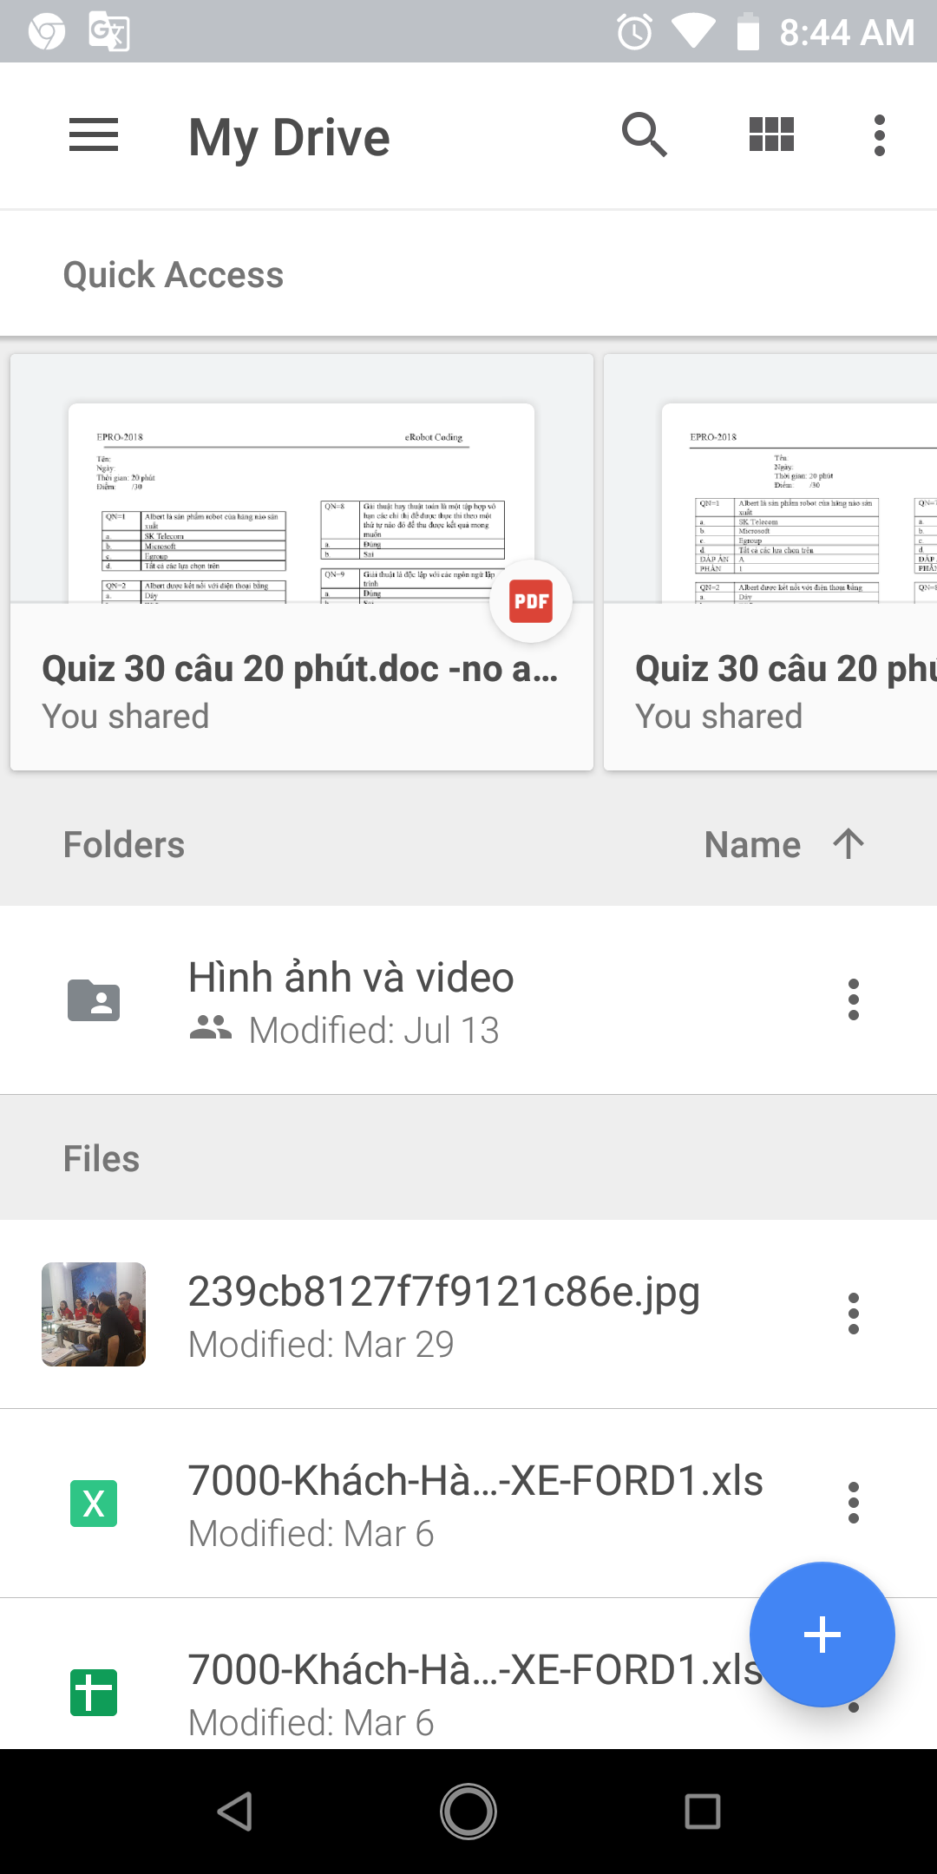
Storage Access Framework
The Storage Access Framework
Storage Access Framework provides an intuitive user interface that allows the user to browse, select, delete and create files hosted by storage services from within Android applications
Document providers can range from cloud-based services to local document providers running on the same device as the client application

Slide 6
Storage Access Framework
The Storage Access Framework
Storage Access Framework provides an intuitive user interface that allows the user to browse, select, delete and create files hosted by storage services from within Android applications
Document providers can range from cloud-based services to local document providers running on the same device as the client application

Slide 7
Storage Access Framework
Working with the Storage Access Framework A set of Intents designed to integrate the features of the Storage Access Framework into Android applications. These intents display the Storage Access Framework picker user interface to the user and return the results of the interaction to the application via a call to the onActivityResult() method of the activity that launched the intent
ACTION_OPEN_DOCUMENT
ACTION_CREATE_DOCUMENT
Notes:
· ACTION_OPEN_DOCUMENT – Provides the user with access to the picker user interface so that files may be selected from the document providers configured on the device. Selected files are passed back to the application in the form of Uri objects. · ACTION_CREATE_DOCUMENT – Allows the user to select a document provider, a location on that provider’s storage and a file name for a new file. Once selected, the file is created by the Storage Access Framework and the Uri of that file returned to the application for further processing

Slide 8
Storage Access Framework
Filtering Picker File Listings
https://en.wikipedia.org/wiki/Media_type#List_of_common_media_types
int OPEN_REQUEST_CODE = 41; Intent intent = new Intent(Intent.ACTION_OPEN_DOCUMENT); startActivityForResult(intent, OPEN_REQUEST_CODE);
intent.addCategory(Intent.CATEGORY_OPENABLE);
intent.setType("image/*");

Slide 9
Storage Access Framework

Slide 10
Storage Access Framework Example
The Android application created in this chapter will take the form of a rudimentary text editor designed to create and store text files remotely onto a cloud based storage service. In practice, the example will work with any cloud based document storage provider that is compatible with the Storage Access Framework, though for the purpose of this example the use of Google Drive is assumed.

Slide 11
Storage Access Framework Example
Creating the Storage Access Framework Example

Slide 12
Storage Access Framework Example
Declaring Request Codes Working with files in the Storage Access Framework involves triggering a variety of intents depending on the specific action to be performed. Invariably this will result in the framework displaying the storage picker user interface so that the user can specify the storage location. The requestCode helps you to identify from which Intent you came back. When the work of the intent is complete, the application will be notified by a call to a method named onActivityResult().
private static final int CREATE_REQUEST_CODE = 40; private static final int OPEN_REQUEST_CODE = 41; private static final int SAVE_REQUEST_CODE = 42;

Slide 13
Storage Access Framework Example
Creating a New Storage File
public void newFile(View view) { Intent intent = new Intent(Intent.ACTION_CREATE_DOCUMENT); intent.addCategory(Intent.CATEGORY_OPENABLE); intent.setType("text/plain"); intent.putExtra(Intent.EXTRA_TITLE, "newfile.txt"); startActivityForResult(intent, CREATE_REQUEST_CODE); }

Slide 14
Storage Access Framework Example
The onActivityResult() Method
public void onActivityResult(int requestCode, int resultCode, Intent resultData) { Uri currentUri = null; if (resultCode == Activity.RESULT_OK) { if (requestCode == CREATE_REQUEST_CODE) { if (resultData != null) { textView.setText(""); } }
}
}

Slide 15
Storage Access Framework Example
Saving to a Storage File
public void saveFile(View view) { Intent intent = new Intent(Intent.ACTION_OPEN_DOCUMENT); intent.addCategory(Intent.CATEGORY_OPENABLE); intent.setType("text/plain"); startActivityForResult(intent, SAVE_REQUEST_CODE); }
else if (requestCode == SAVE_REQUEST_CODE) { if (resultData != null) { currentUri = resultData.getData(); writeFileContent(currentUri); } }

Slide 16
Storage Access Framework Example
Write file content
private void writeFileContent(Uri uri) { try{ ParcelFileDescriptor pfd = this.getContentResolver().openFileDescriptor(uri, "w"); FileOutputStream fileOutputStream = new FileOutputStream( pfd.getFileDescriptor()); String textContent = textView.getText().toString(); fileOutputStream.write(textContent.getBytes()); fileOutputStream.close(); pfd.close(); } catch (Exception e) { e.printStackTrace(); } }

Slide 17
Storage Access Framework Example
Opening and Reading a Storage File
public void openFile(View view) { Intent intent = new Intent(Intent.ACTION_OPEN_DOCUMENT); intent.addCategory(Intent.CATEGORY_OPENABLE); intent.setType("text/plain"); startActivityForResult(intent, OPEN_REQUEST_CODE); }
else if (requestCode == OPEN_REQUEST_CODE) { if (resultData != null) { currentUri = resultData.getData(); try { String content = readFileContent(currentUri); textView.setText(content); } catch (IOException e) { // Handle error here } } }

Slide 18
Storage Access Framework Example
Read file method
private String readFileContent(Uri uri) throws IOException { InputStream inputStream = getContentResolver().openInputStream(uri); BufferedReader reader = new BufferedReader(new InputStreamReader( inputStream)); StringBuilder stringBuilder = new StringBuilder(); String currentline; while ((currentline = reader.readLine()) != null) { stringBuilder.append(currentline + "\n"); } inputStream.close(); return stringBuilder.toString(); }

Slide 19
Storage Access Framework Example
Testing the Storage Access Application

Slide 20

End of Lesson 17

Slide 21
Thank you!

